Slide 1

TOP Hit Prediction
Applied Data Science

Slide 2
Scope
Identify Possible top hits per region based on song features
Notes:
Introduction to use case, goal, selection of data set

Slide 3

Domain Exploration - Hit Song Science
Area first defined by Mike McCready in 2002 (CEO of Polyphonic)
Goal/Business Model:
Evaluate Hits before they are released
Identify & match musical preferences of certain groups
Original Procedure: Analyze mathematical structure of rhythm, changes in key & melodic pattern
Notes:
Brief literature review about domain and previous data science projects in this domain
Sources:
Ruth Dhanaraj; Beth Logan (2005) „AUTOMATIC PREDICTION OF HIT SONGS”
Internet → Web Archive 2005:
https://hitsongscience.com/
http://www.polyphonichmi.com/about_us.php

Slide 4
Domain Exploration – Previous Data Science Projects
Goals | Input | Result
Predict Song Popularity (>90%) | Spotify API | 75% Accuracy
Predict Hit in Billboard Hot 100 | Spotify API & Million Song Data Set (MSD) | 69 - 77% Accuracy 81 – 89% Accuracy
Determine Variation of Attributes to Streams | Spotify API | Low Explanatory Power
Determine Variation of Attributes to Popularity | Spotify API | Mixed Explanatory Power
Determine Features of Successful Playlists | Spotify API & Surveys | Intimacy, Focus & Variety
Characterize Trendy Music Clusters | Spotify API | Variety of Size & Attributes
Multiple Approaches
Different Goals & Data Input
Different Results
Notes:
Sources:
Dawson, Christopher E. Jr.; Mann, Steve; Roske, Edward; and Vasseur, Gauthier (2021) "Spotify: You have a Hit!," SMU Data Science Review: Vol. 5: No. 3, Article 9.
Georgieva, Elena; Suta Marcella; Burton, Nicholas: “HITPREDICT: PREDICTING HIT SONGS USING SPOTIFY DATA” (2018)
George John Jordan Thomas Aquinas Hayward „What makes a playlist succesful? “ (https://ghayward.github.io/assets/files/Data_Scientist_Presentation_George_JJTA_Hayward.pdf)
Spera, Carola; Sciandra, Marangela “A Model Based Approach to Spotify Data Analysis: A Beta GLMM” (2022)
Nijkamp, Rutger “Prediction of product success: explaining song popularity by audio features from Spotify data” (2018)
All Kind of Methods:
Regression
Clustering
Classification
Multiple Methods:
To be Clarified
Comment:
Table excludes methods on purpose as this would go to much into detail

Slide 5

Domain Exploration
Go for Use Case
Decision of Data Base
Limitations:
Bias due to Spotify API
Limited to Data Base Info e.g. No Genre
No Details of Calculation
Excludes Soft Factors

Slide 6
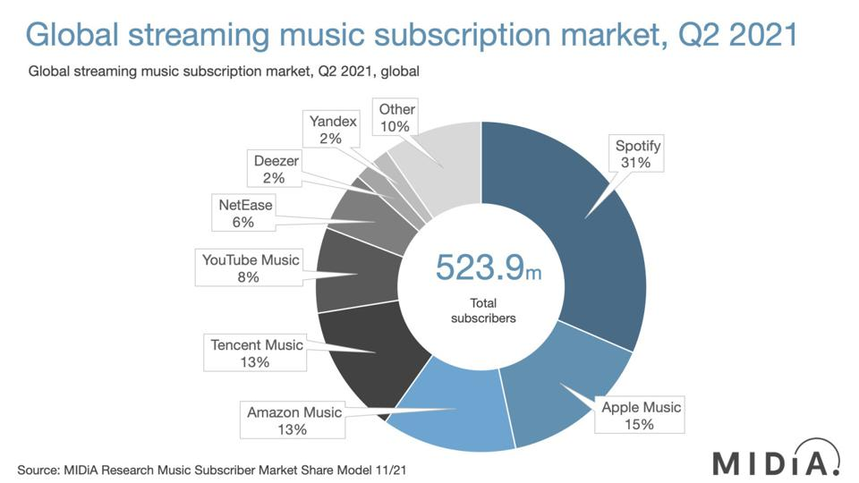
Notes:
Source: Forbes
https://www.forbes.com/sites/eamonnforde/2022/01/19/spotify-comfortably-remains-the-biggest-streaming-service-despite-its-market-share-being-eaten-into/?sh=6f71a5134743

